Slide 1
TA
1、2
3、4
5、6
16
22
15
21
Blackboard
Robot Hockey Arena
14
19 、 20
7、8
9、10
11、12
13
17 、 18
ICN5406/5058
Floor plan EE632

Slide 2
Checkpoint #4 Full Function Demonstration
Demo Due: 11/26/2021
Report Due: 12/03/2021

Slide 3
Outline
CP 4 Supplies Check
Checkpoint #4
Introduction to IR receiver
Goal Seeking
Checkpoint#4 Grading Policy

Slide 4
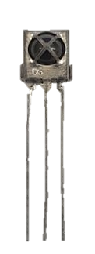
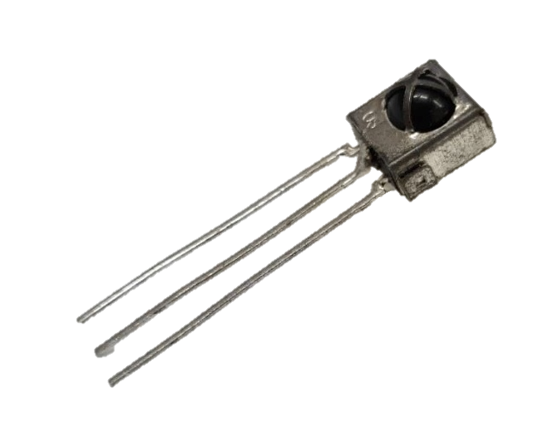
CP 4 Supplies

Slide 5
Checkpoint#4 Assignment
Mobile robot can detect beacon signals and move towards it.
Combine all the function together for robot hockey contest.
Obstacle Avoidance
Hockey Seeking (Light-ball detection)
Goal Seeking (IR signal receiving and moving toward goal)
Two infrared diodes will be set up at opposite ends of an arena. Each diode will be emitting light modulated at 38 KHz, but their pulse width are different when received by IR receiver module.

Slide 6
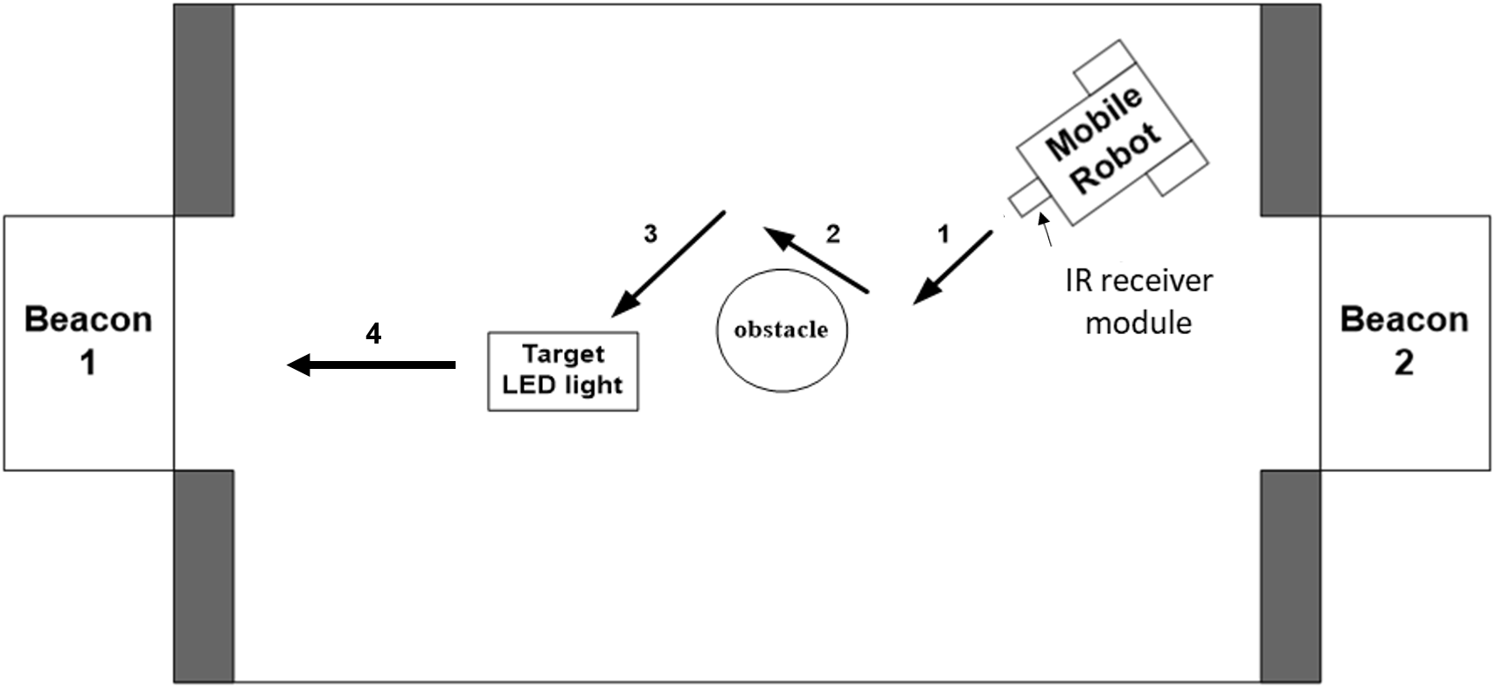
Arena

Slide 7
IR receiver
Using IR receiver to find beacons(Beacon-1 600 and Beacon-2 1500) which is the goal.
OS
Signal/Output
GND
5V

Slide 8
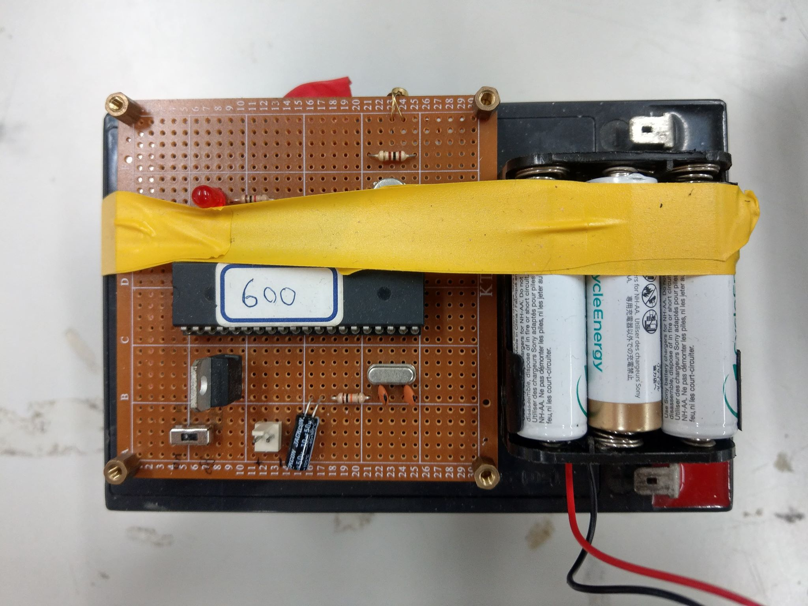
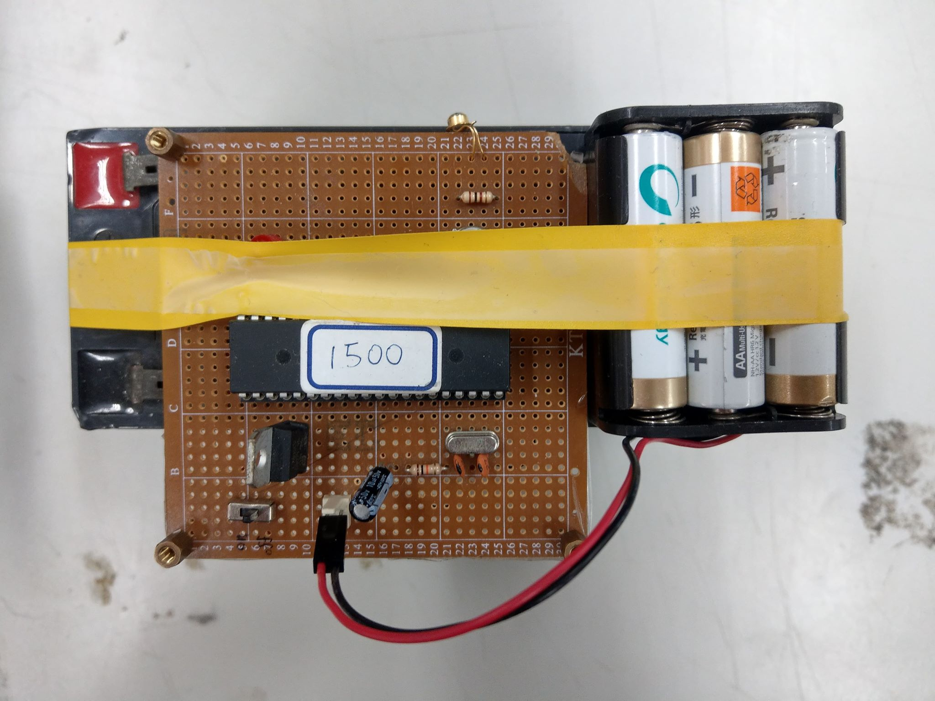
Beacon (Provided by TA)
Two infrared diodes are set up at opposite ends of the arena.
Each Beacon will emit light modulated at 38KHz, but their pulse widths are different when received by the IR receiver module.
Beacon1 600
Beacon2 1500

Slide 9
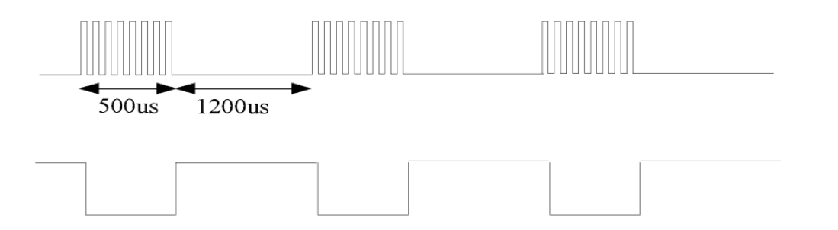
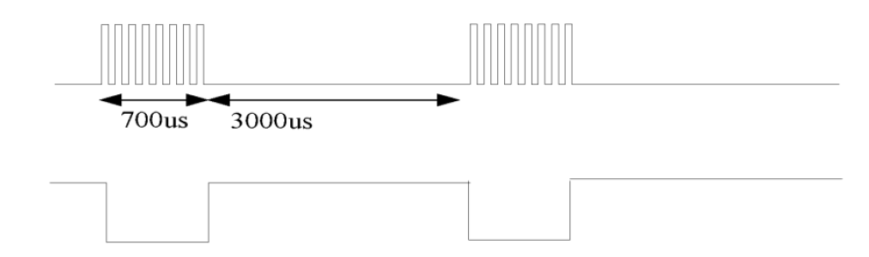
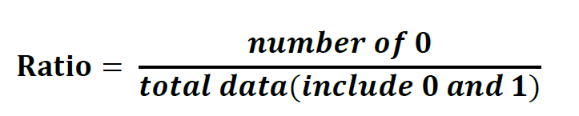
Beacon
Beacon-1 600
Beacon signal
1
IR receiver
0
Beacon-2 1500
Beacon signal
IR receiver
1
0
Receive IR data for a period of time(≥0.1 seconds) and calculate the pulse proportion.
$$\left\{\begin{aligned}\text{If} \text{your} \text{goal} \text{door} \text{is} \text{Beacon}\text{1_ 600, }\text{the} \text{ratio} \text{is} \text{between}\text{ 0.27 }\text{and}\text{ 0.32.} \\ \text{If} \text{your} \text{goal} \text{door} \text{is} \text{Beacon}\text{2_ 1500, }\text{the} \text{ratio} \text{is} \text{between}\text{ 0.17 }\text{and}\text{ 0.22. } \end{aligned}\right.$$

Slide 10
Grading Policy
Have the ability to avoid all the obstacle in the arena. (10%)
Capture the hockey puck. (10%)
Your robot should be able to find two different beacons (Beacon1_600 and Beacon2_1500) and move to the specified beacon in the arena. Robot brings the puck into the goal , respectively, of Beacon1 and Beacon2. (50%) (For any one Beacon : 40%; the second one 10%)
The time to complete the goal of Beacon1_ 600 or the goal of Beacon2_1500 (30%) (The fastest) . Should complete the mission for any one goal in 60sec.

Slide 11
Deadline
--------------------------------------------------------
Checkpoint#4 Demo : 11/26
Checkpoint #4 Report : 12/03

Slide 12
CP3 Demo Timetable
Group A 09:30 ~ 10:30 | Group B 10:30 ~ 12:00
Team 1 | Team 12
Team 2 | Team 13
Team 3 | Team 14
Team 4 | Team 15
Team 5 | Team 16
Team 6 | Team 17
Team 7 | Team 18
Team 8 | Team 19
Team 9 | Team 20
Team 10 | Team 21
Team 11 | Team 22

